Slide 1
10.03 Meeting - 2
吳定洋
1

Slide 2

Table of contents
01
02
Fine-tune model Strategy
Wi-Fi RTT Equipment
03
Wi-Fi CSI related
2

Slide 3

01
Fine-tune model Strategy
Some related research
3

Slide 4
How to Fine-tune Models with Few Samples: Update, Data Augmentation, and Test-time Augmentation
Main contribution:
Update model :
DA (data Augmentation)
transfer pre-train model to few-shot downstream task (FSL, few shot learning)
FT (full-fine tuning) and LP (linear probing) update strategy based on the amount of training data
Training state
Test state
4

Slide 5
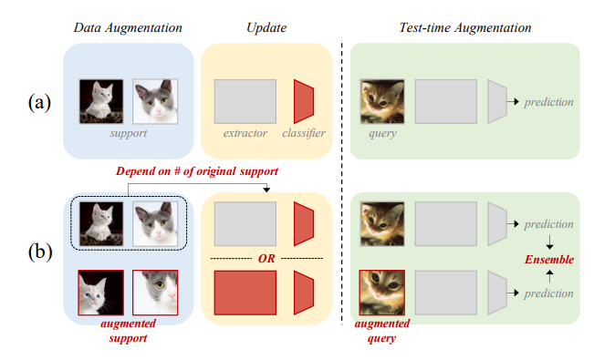
Illustrate the proposed strategy
Transfer-based FSL
Pre-train model state
Update state
Update state
FT: Feature extractor and linear classifier
LP: linear classifier only
Augmentation
Data
Test-time
increase the diversity of training data by applying transformations
(b) Proposed strategy applying to the model
5

Slide 6
What is FSL
FSL: learning in situations where very few labeled examples are available for each class.
Example:
5-way 1-shot setup: Model classify samples into one of 5 classes, but it is provided with only 1 labeled example per class
Support Set: Small set of labeled examples provided for each class
Query Set: Model needs to classify after learning from the support set
Update model: FT or LP
6

Slide 7
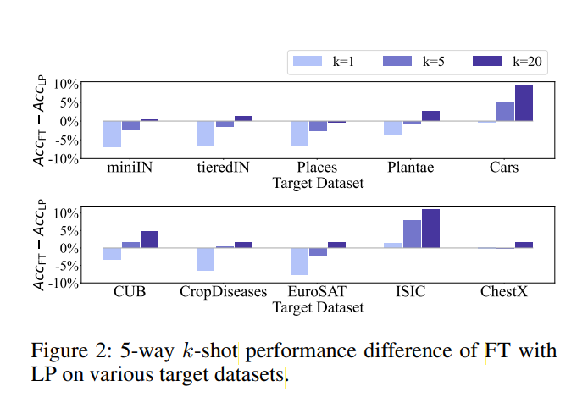
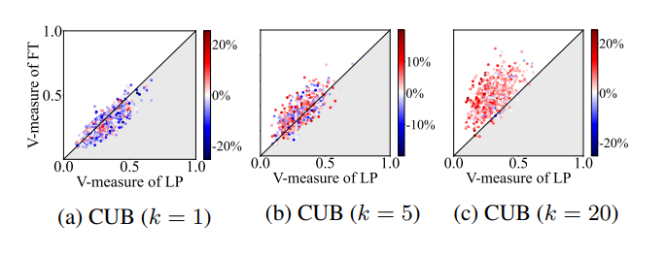
FT, LP scenario
When k is large, FT is better
When K is extremely small, LP is better
7

Slide 8
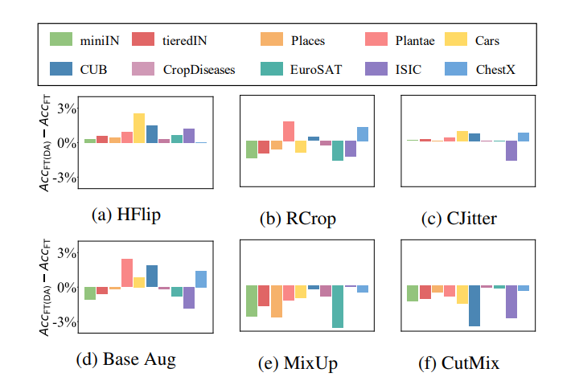
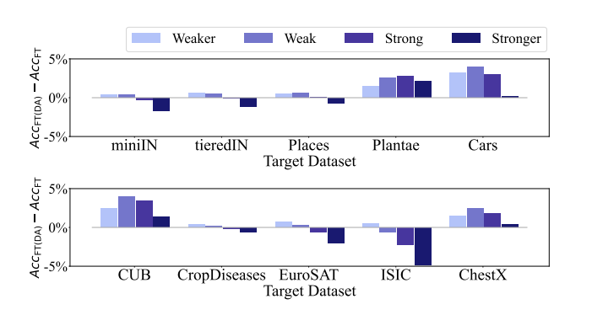
DA (Data Augmentation)
(a) HFlip: Horizontal Flip. (b) RCrop: Random Crop. (c) CJitter: Color Jitter (抖動). (d) Base Aug: Basic augmentation techniques (a combination of horizontal flip, random crop, and color jitter). (e) MixUp: MixUp is a technique that linearly mixes two images. (f) CutMix: CutMix is a technique that combines parts of two images by patching areas together.
8

Slide 9

02
Wi-Fi RTT Equipment
Finding something we can use
9

Slide 10
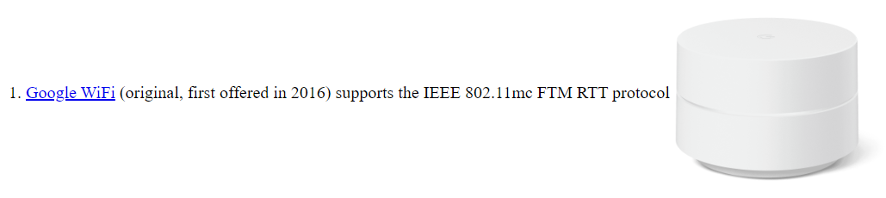
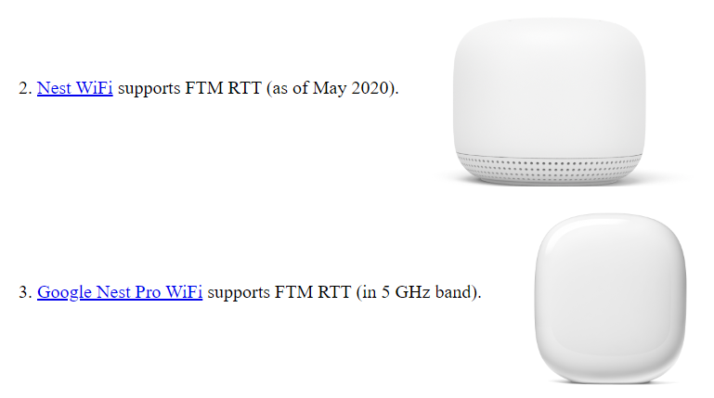
Wi-Fi AP Support 802.11mc for RTT usage
Support RTT in 5GHz range mode
10
https://people.csail.mit.edu/bkph//FTMRTT_aps

Slide 11

03
Wi-Fi CSI related
Hardware Setup and human action detection
11

Slide 12
Using Raspberry Pi as CSI Receiver
Paper : Wi-Fi-based Human Activity Recognition using Raspberry Pi
Main contributions:
CSIKit : Python framework for interacting with data from a range of CSI
hardware
DeepConvLSTM : model is well-suited to the CSI data produced by the Pi4
Using Raspberry Pi to receive and extract CSI data in transmission
Like most CSI-related papers, this paper also explains CSI and its physical significance.
12

Slide 13
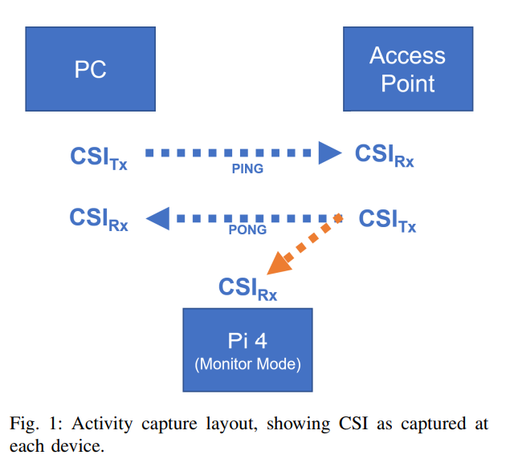
Relation between PC, AP and Pi
PC:
Generates traffic by sending ping packets to the AP. –
CSI can be captured from this traffic.
AP:
Responds to the PC with pong packets.
Pi:
Captures the CSI from the pong packets sent by the AP.
This CSI contains details about RF (radio frequency) and physical disturbances between the AP and Pi.
13

Slide 14
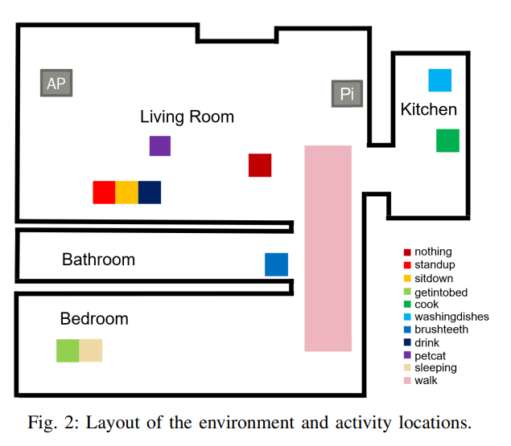
Environment and Experimental SETUP
Raspberry Pi 4
Running Debian 10 with nexmon_csi
Nexmon
Channel: 36/80, Core: 1, NSS mask: 1, Delay: 30us.
MAC address filter set for the AP.
AP
Sky ER110 wireless router using 5GHz, Channel 36 at 80MHz
A separate device generates traffic by sending flood pings to the AP every 0.01 seconds.
CSI timesteps can be linearly interpolated to approximately 100Hz.
14

Slide 15
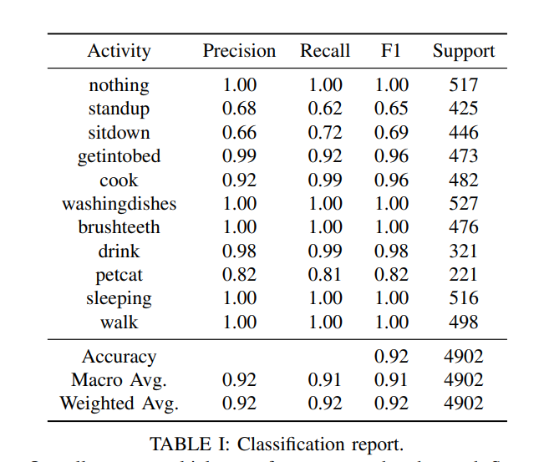
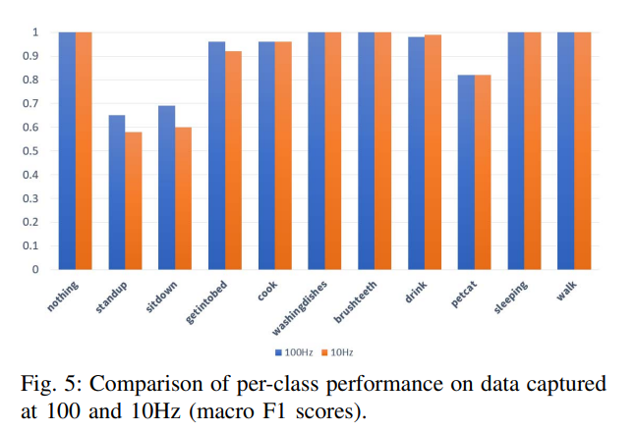
Performance and Discussion
15

Slide 16
Reference
How to Fine-tune Models with Few Samples: Update, Data Augmentation, and Test-time Augmentation
https://arxiv.org/abs/2205.07874
WiFi-based Human Activity Recognition using Raspberry Pi
https://ieeexplore.ieee.org/document/9288199
16

Slide 17

Thanks for Lestening!
17

